Slide 1
PPM Training
By Tianyuan Wang

Slide 2
Agenda
Introduce Active Codes
Introduce PPM Report
Must Do and Must Not Do
What PPM data can do
Any requirement to PPM
QA

Slide 3
Active Codes

Slide 4
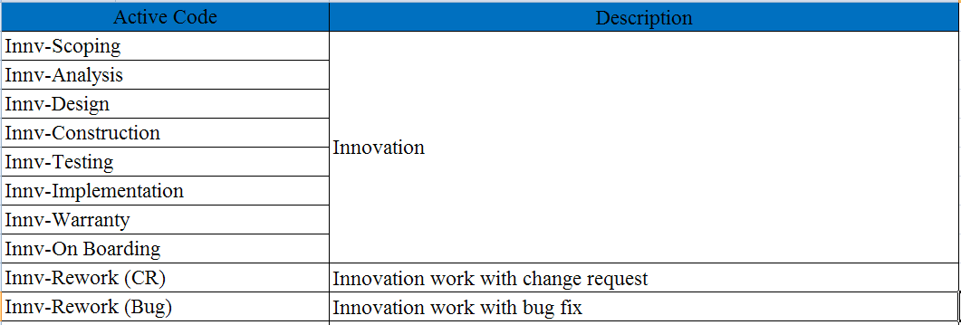
Active Code Instruction

Slide 5
Active Code Instruction
S-<Description> | Supports

Slide 6
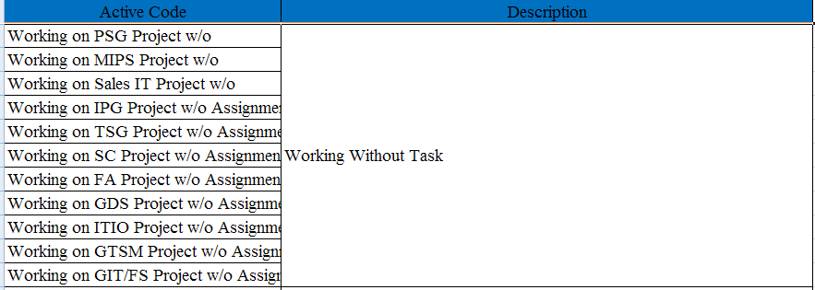
Active Code Instruction
Available For Assignment | Non working time that can be used for any other activity, i.e. Idle time

Slide 7
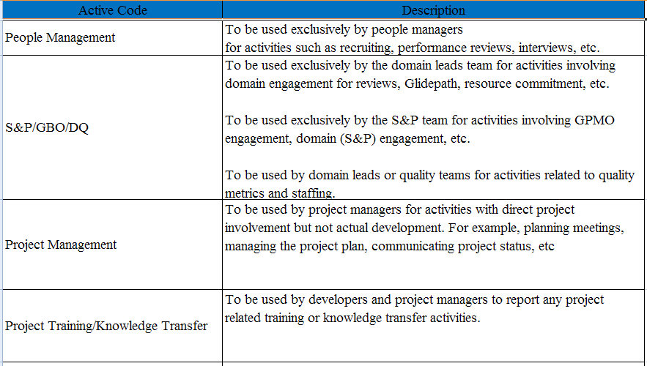
Active Code Instruction

Slide 8
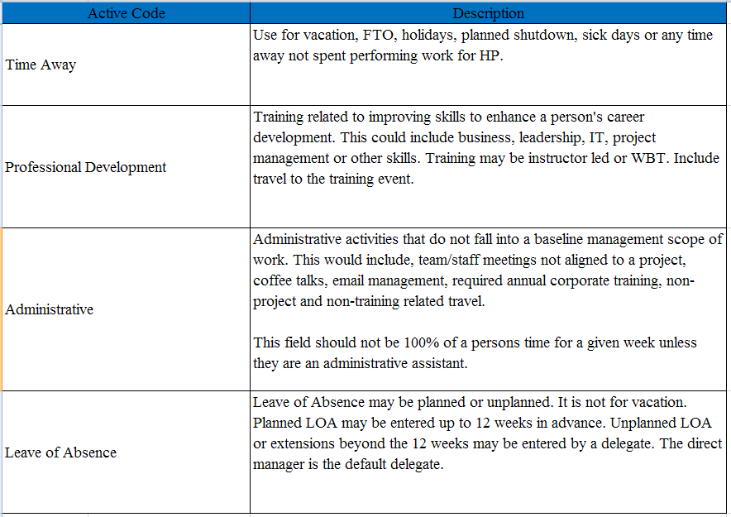
Active Code Instruction

Slide 9
PPM Report

Slide 10
PPM Report Introduction (Time Summary)
Timesheet weekly Compliance Report
  Reason:
    If you forget to fill the PPM time sheet. You will be on this part of report.
  Priority:
    Very important. No exception is acceptable.
  Actions:
    Re-work is required.
    Quality team and PM will notice you.

Slide 11
PPM Report Introduction (Time Summary)
Number of resources with approved timesheet to closed projects
  Reason:
    Log time to a closed project.
  Priority:
    Important.
  Actions:
    Re-work is required.
    Quality team will notice you.

Slide 12
PPM Report Introduction (Time Summary)
Number of resources with an "Approved" timesheet and has time to a project that is "On Hold”, “Cancelled", or a "Candidate".
  Reason:
    Log time to a not in progress project.
  Priority:
    Important.
  Actions:
    Re-work is required.
    Quality team will notice you.

Slide 13
PPM Report Introduction (Time Summary)
Number of resources with an "Approved" timesheet and has 100% of their time to MISC category "Leave of Absence".
  Reason:
    Log all time to “Leave of Absence”.
    CWF can not log time to this.
  Priority:
    Medium.
  Actions:
    Mostly re-work is required.
    Quality team will notice you and your PM.

Slide 14
PPM Report Introduction (Time Summary)
Number of resources with an "Approved" timesheet and has 100% of their time to MISC category "Other".
  Reason:
    Log all time to “Other”.
    CWF can not log time to this.
  Priority:
    Medium.
  Actions:
    Re-work is required.
    Quality team will notice you.

Slide 15
PPM Report Introduction (Time Summary)
Number of resources that are missing either a Role, a Task or both.
  Reason:
    Missing role or task in PPM. PM need to add it for you.
  Priority:
    Medium.
  Actions:
    PM assign role or task is required.
    Quality team will notice you PM.

Slide 16
PPM Report Introduction (Time Summary)
Number of resources with approved timesheet totaling less than 40 hours.
  Reason:
    Total hour is less than 40 hours. (For Regular only)
  Priority:
    Medium.
  Actions:
    Re-work is required.
    Quality team will notice you.

Slide 17
PPM Report Introduction (Time Summary)
Number of resources with approved timesheet totaling larger than 60 hours.
  Reason:
    Total hour is over 60 hours.
  Priority:
    Low.
  Actions:
    Quality team will notice you and your PM if you are a real working machine.

Slide 18
PPM Report Introduction (Time Summary)
Number of resources with an "Approved" timesheet and 50% of the hours logged to "Administration".
  Reason:
    Over 50% time to "Administration". And you are not AA.
  Priority:
    Low.
  Actions:
    Re-work is required.
    Quality team will notice you.

Slide 19
PPM Report Introduction (Time Summary)
Number of resources with an "Approved" timesheet and 100% of the hours logged to "Professional Development“.
  Reason:
    All time to " Professional Development".
    CWF can not log time to this.
  Priority:
    Low.
  Actions:
    Quality team will notice you. Just confirm the time sheet.

Slide 20
PPM Report Introduction (Time Summary)
Number of resources with an "Approved" timesheet and 100% of the hours logged to "Time Away"
  Reason:
    All time to " Time Away".
    CWF can not log time to this.
  Priority:
    Low.
  Actions:
    Quality team will notice you. Just confirm the time sheet.

Slide 21
PPM Report Introduction (Time Summary)
Incorrect records repot.
  Reason:
    Active code mis-matching.
  Priority:
    Medium.
  Actions:
    Re-work is required.
    Quality team will notice you.

Slide 22
PPM Report Introduction (Metrics)
Weighted tasks/resource .
  Calculation:
    Average for (Core Effort/5).
  Description:
    Average number of simple tasks for each people.
    Base line is 8.0 ( [8 hours/day] * [5 days/week] / [5 hours/simple task]=8 simple task/week)
    Only core effort is calculated (time away is not included)

Slide 23
PPM Report Introduction (Metrics)
% Core efforts.
  Calculation:
    (Core Effort/Total Effort)*100%.
  Description:
    How much spend on core effort.
    No base line.

Slide 24
PPM Report Introduction (Metrics)
Task/resource.
  Calculation:
    Average of Task number for each person.
  Description:
    How many task in PPM.
    Time away is not included.
    Each activity code in Project will be count as one task.
    Each non 0 activity in Mis will be count as one task.

Slide 25
PPM Report Introduction (Metrics)
% Overutilized resource.
  Calculation:
    (Over utilized people number/total number of people)*100%
  Description:
    Over 120% utilized people will be counted.

Slide 26
PPM Report Introduction (Metrics)
% Underutilized resource.
  Calculation:
    (Under utilized people number/total number of people)*100%
  Description:
    Less than 80% utilized people will be counted.

Slide 27
Must/Must not Do

Slide 28
Must Do and Must Not Do
PM
  Make sure all employee has role and task.
  Make sure all employee has filled the PPM.

Slide 29
Must Do and Must Not Do
Regular
  Fill the PPM time sheet weekly in time.
  As least 40 hours are filled each week.
  No time log to “Leave of Absence”.
  No invalid record. (Active code mis-match).
  Not over 50% on “Administrative”.
  Not Copy last week time sheet.

Slide 30
Must Do and Must Not Do
CWF
  Fill the PPM time sheet weekly in time.
  If no work in a whole week, submit a blank time sheet please.
  No invalid record. (Active code mis-match).
  Not over 50% on “Administrative”.
  No time log to “Leave of Absence”.
  No time log to “Professional Development”.
  No time log to “Time Away”.
  Not copy last week time sheet

Slide 31
PPM Data Usage

Slide 32
What PPM data can do
PPM Data Have:
  Project Information
  Task Information
  Hard booking
  Plan Effort
  Actual Effort
  Effort Allocation

Slide 33
What PPM data can do
PPM Can be used in: (Green pare is the PPM Data)
  Productivity:
    (Plan effort/Actual Effort)*1.6
  Requirements volatility
    (Planned Effort for CR/Total Planned Effort for a release) * Phase factor
  Delivered defect density
    Weighted delivered defects/Total number of simple tasks delivered
    Total number of simple tasks delivered = (Actual Effort)/5
  Utilization
    (Actual Effort/Plan Effort)*100%
  Effort Allocation
    How is the time allocated among different works.

Slide 34
But How...... ?

Slide 35
Sample Usage

Slide 36
Require to PPM?

Slide 37
Requirement to PPM
What you hope PPM can do?
  Collect feedback
  Report correct
  PPM interface can be coded
  Delete all confuse task, active code
Any issue using PPM?
  Documentation
  Create a list on the sharepoint to collect the feedbacks

Slide 38
References
PPM Raw Data:
http://gdcckm.chn.hp.com/teams/ams/management/AMS_Management/Quality/AMS%20Section/default.aspx?RootFolder=%2fteams%2fams%2fmanagement%2fAMS%5fManagement%2fQuality%2fAMS%20Section%2fShared%20Documents%2f30%2e%20CDC%20Tarsan%20DQT%2fPPM%20Weekly%20Reports%2fCDC%20Timesheet%20weekly%20summary&View=%7b004E1098%2d7C4E%2d4D8D%2d8E46%2d783C21B3266C%7d

Slide 39

Q&A

Slide 40

Thank you!
Thank you

